Slide 1
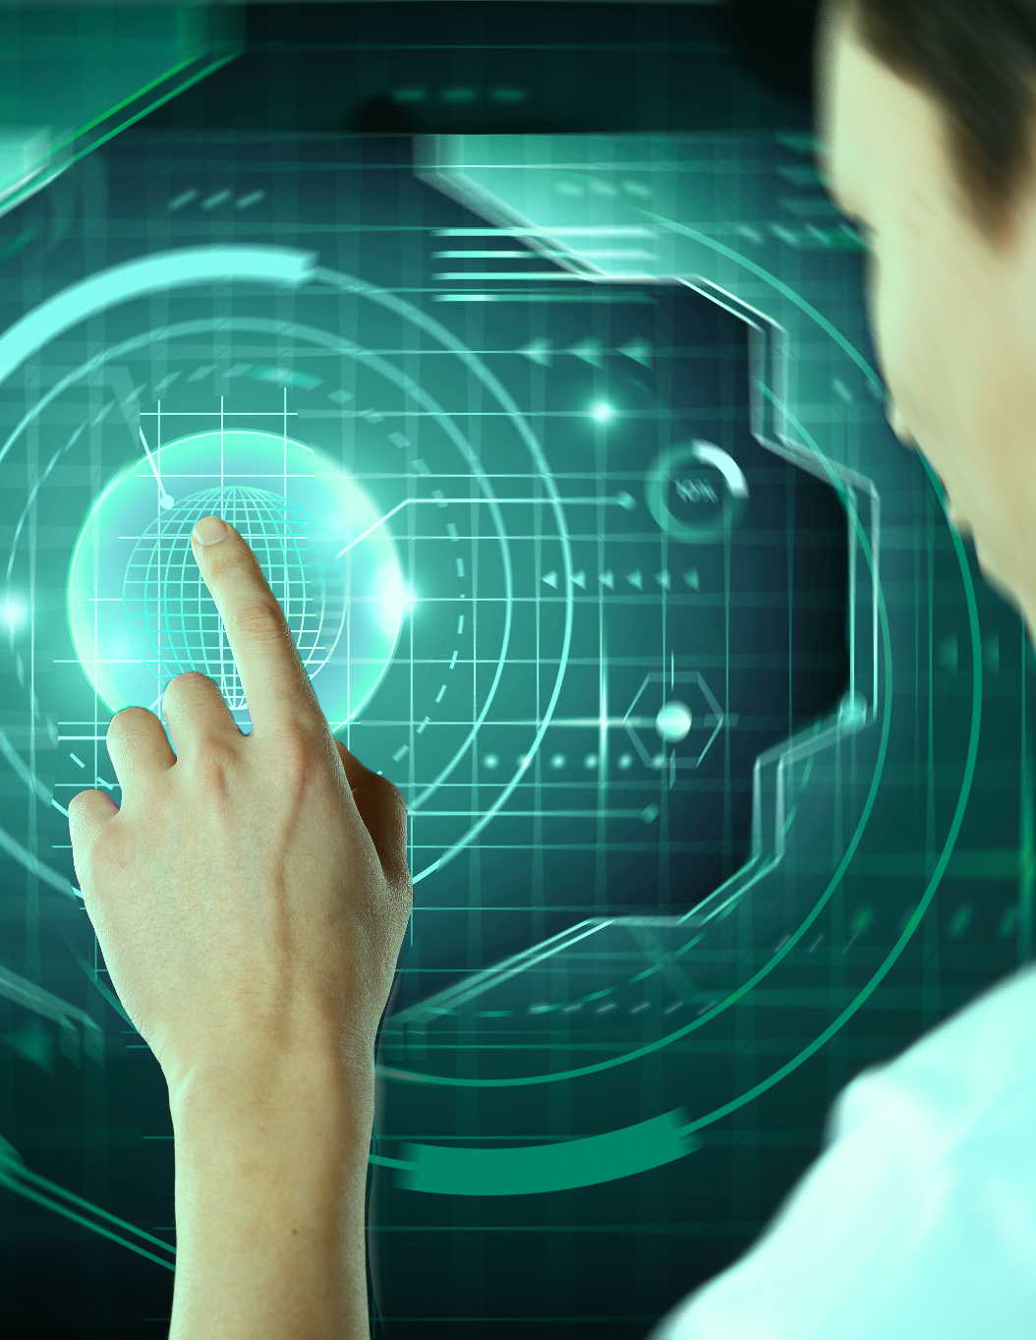

Customer Segmentation Using Data Science
Group:- 12
Guide Faculty:- Mr. Manoj Kumar

Slide 2








Group 12
Subham
Rishabh
Priyam
Yashaswi
20BAI10051
20BAI10060
20BAI10087
20BAI10327

Slide 3
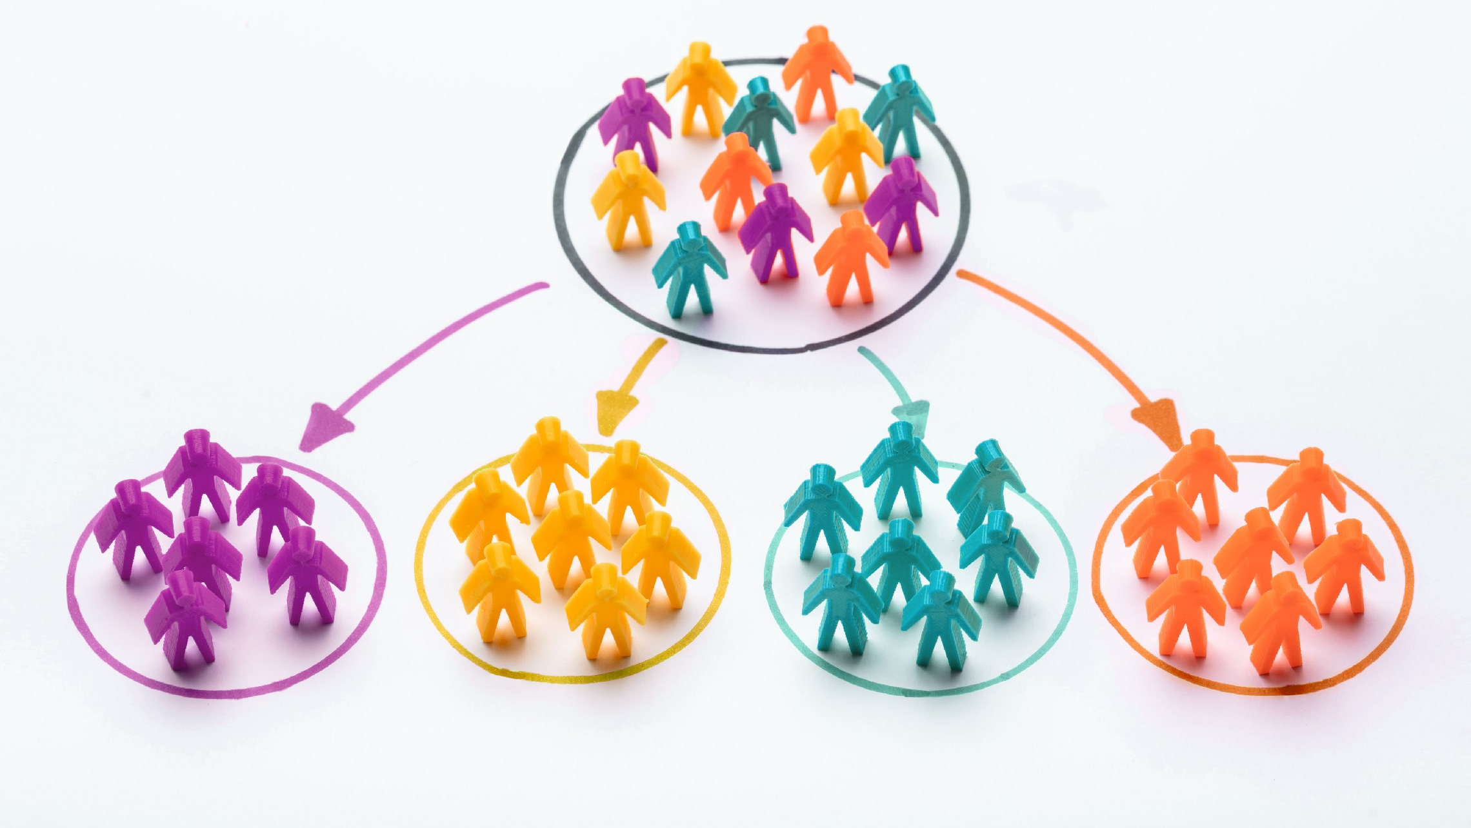
Introduction
Customer segmentation is the practice of dividing a company’s customers into groups that reflect similarity among customers in each group.
The goal of segmenting customers is to decide how to relate to customers in each segment in order to maximize the value of each customer to the business.
Accurate customer segmentation allows marketers to engage with each customer in the most effective way.

Slide 4
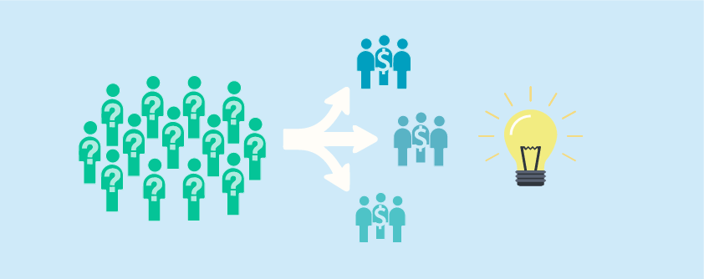
Benefits of Customer Segmentation
Identifies opportunities for new product development.
Helps designing marketing programs most effective for reaching homogenous group of buyers
Improves allocation of marketing resources

Slide 5
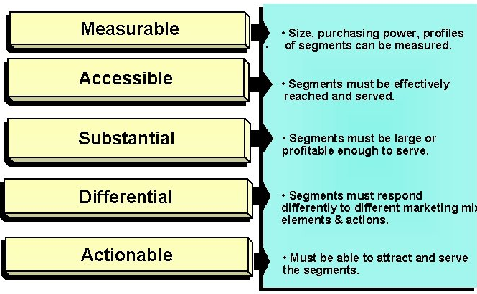
Requirements for Customer Segmentation

Slide 6
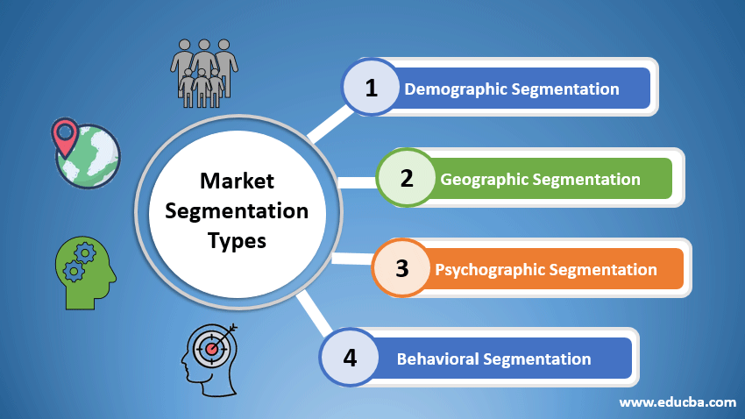

Slide 7
EXISTING WORK WITH LIMITATION
Previously information about the users were recorded in a database and a user has to manually sit and note the various kinds of information, but with the development of ML algorithms , no additional manpower is required as a machine is itself capable of sorting and separating the required data from datasheet .
What we have proposed and done is uniquely divided the data into different field which will provide the client more insights about the product.

Slide 8
Proposed Work and Methodology
For this project, we will be going to use unsupervised learning to group your customers into clusters based on individual aspects such as age, gender, region, interests, and so on.
K-means clustering or hierarchical clustering will be then applied with the following steps:
Business Care
Data Preparation
Segmentation with K-means Clustering
Hyperparameter Tuning
Visualization and Interpretation of Results

Slide 9


NOVELTY OF THE PROJECT
The technology we have worked with in creating our project is mainly unsupervised meaning that no human assistance will be needed to segmentate the customers and the machine will be able to produce results by itself .
Furthermore, we have decided to break the customer information into many segments which will not only help the client in knowing the market but also help in product popularity.

Slide 10


Real Time Usage
With Shows like Shark Tank becoming everyone's favorite and the skills and feeling of entrepreneurship on the rise .
It is very important for as start-up or business to know what their target market is and to which age group their product caters and adheres the most.
Hence our model comes in use here by providing the client with detailed and precise knowledge about the client’s buyer group which can help the client to scale up and build the business.

Slide 11


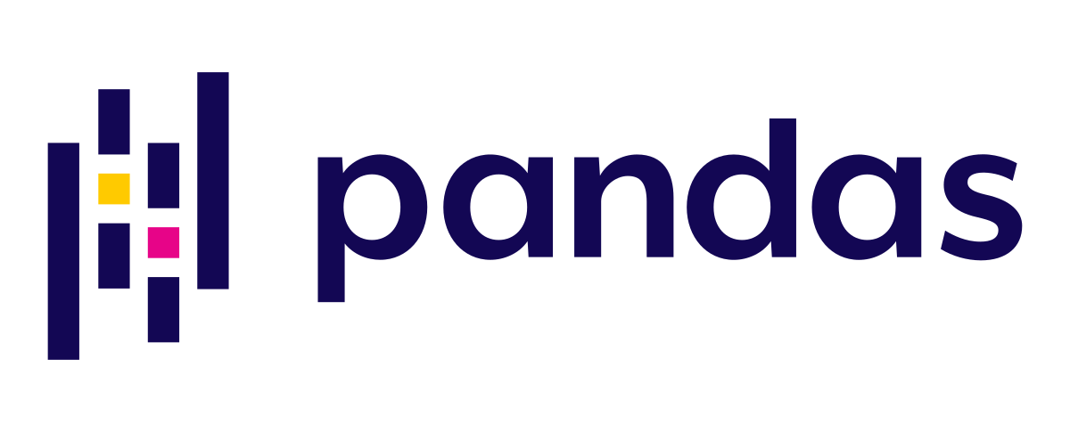
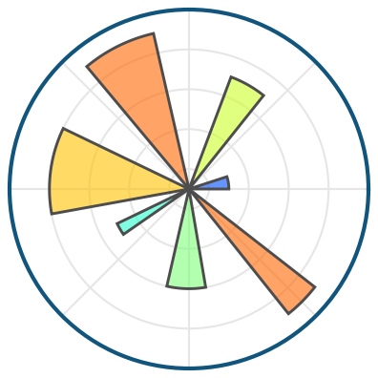


Hardware & Software Requirements
GOOD PROCESSOR
HIGH END GRAPHICS CARD
PYTHON
MATPLOTLIB
JUPYTER
NUMPY
PANDAS
SKLEARN

Slide 12
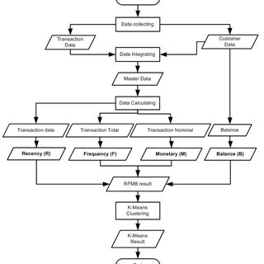
Flow Chart

Slide 13

References
https://towardsdatascience.com/customer-segmentation-in-python-9c15acf6f945
https://www.natasshaselvaraj.com/customer-segmentation-with-python/
https://neptune.ai/blog/customer-segmentation-using-machine-learning
Book Name:
Market Segmentation: How to Do It and How to Profit from It (Book by Malcolm McDonald)
Handbook of Market Segmentation: Strategic Targeting for Business and Technology Firms (Book by Art Weinstein)

Slide 14
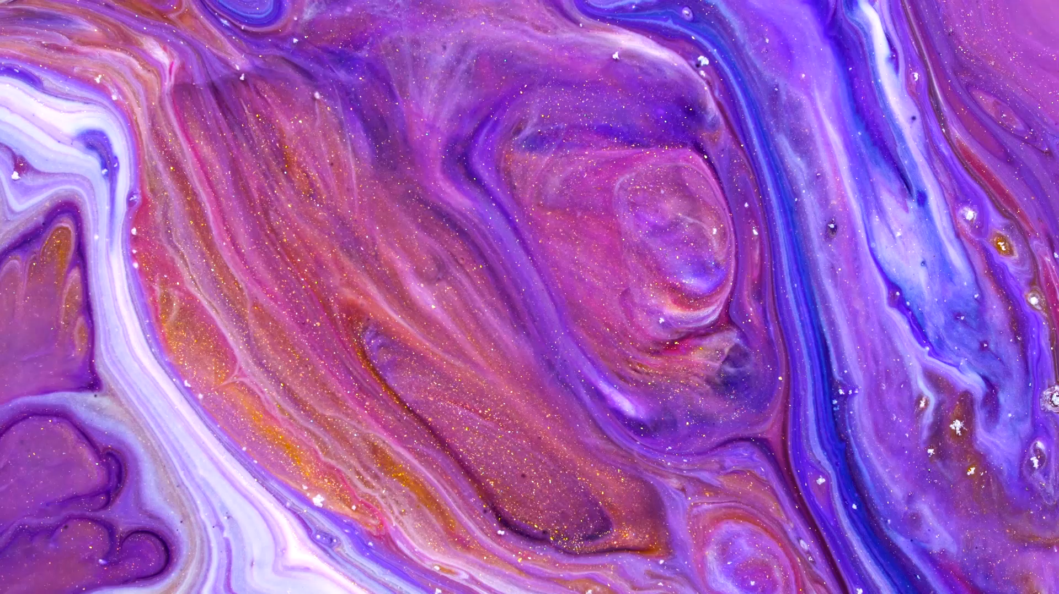
ACKNOWLEDGEMENT
We would like to thank our mentor Mr. Manoj Kumar Sir for supporting us and giving us this wonderful opportunity of presenting such a great project which will be very interesting, and I will also extend my gratitude to all the team members who cooperated and give their best in this project.

